Slide 1
Chapter 14

Slide 2
Objectives

Slide 3
An example that illustrates the scope chain

Slide 4
You can move up the scope chain but not down

Slide 5
What a closure is

Slide 6
An example that illustrates a closure

Slide 7
An example that illustrates a closure (cont.)

Slide 8
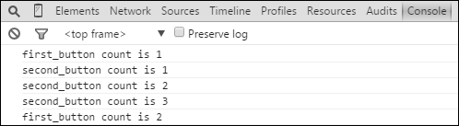
The Console panel after clicking the two buttons several times each

Slide 9
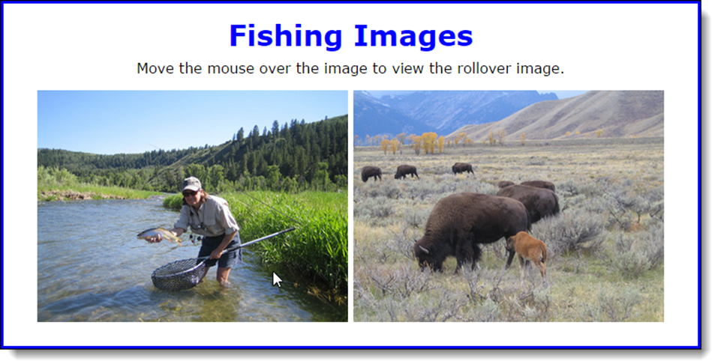
The Rollover application from chapter 13

Slide 10
The JavaScript code for the Rollover app

Slide 11
The properties and methods of the slideshow object from chapter 13

Slide 12
The methods called by code outside the slideshow object

Slide 13
How to use a closure to create private state in the slideshow object

Slide 14
A function expression that is defined and then invoked

Slide 15
An immediately invoked function expression (IIFE)

Slide 16
A function with a normal for loop: i is available throughout the function

Slide 17
A function in an IIFE: i is only available in the loop so it has block scope

Slide 18
What else you need to know about closures

Slide 19
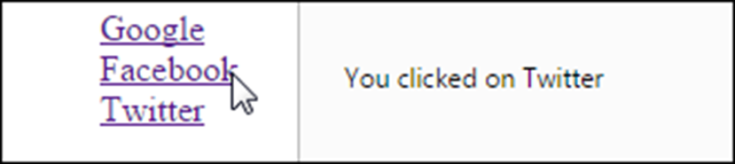
How this creates the loop problem

Slide 20
How to fix the loop problem by calling a function that returns a function

Slide 21
How to fix the loop problem by using an IIFE

Slide 22
An object with a method that returns a closure that throws an error

Slide 23
How to use the bind method to set the value of the closure’s this keyword

Slide 24
How to use a variable to store the outer function’s this keyword value

Slide 25

The Slide Show application in the browser

Slide 26
The head element in the HTML file

Slide 27
The library_slide_show.js file

Slide 28
The library_slide_show.js file (continued)

Slide 29
The library_slide_show.js file (continued)

Slide 30
The main JavaScript file

Slide 31

The slideshow object in the Watch Expressions pane

Slide 32
Some JavaScript methods that use callback functions

Slide 33
Two reasons to use callback functions

Slide 34
Some best practices for writing code that uses callback functions

Slide 35
A utility function that accepts a callback function

Slide 36
An application that uses the utility function with a different callback

Slide 37
An application that uses the utility function with a different callback (continued)

Slide 38
How to set the callback function’s this keyword when calling the function

Slide 39
How to set the callback function’s this keyword when passing the function

Slide 40
How to calculate a factorial using a loop

Slide 41
How to calculate a factorial using a function that calls itself (recursion)

Slide 42
How to improve a recursive function

Slide 43
A binary search recursive function

Slide 44
Code that uses the binary search function

Slide 45
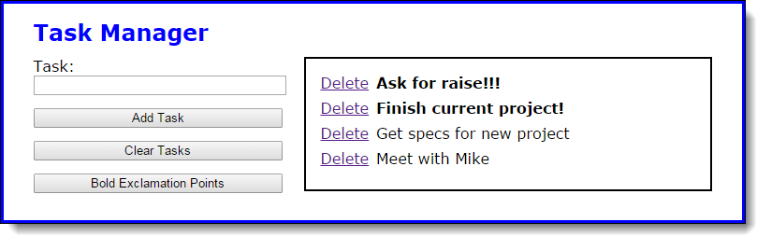
The Task Manager application after the Bold button is clicked

Slide 46
The main element of the HTML

Slide 47
The library_storage.js file

Slide 48
The library_storage.js file (continued)

Slide 49
The library_tasklist.js file

Slide 50
The library_tasklist.js file (continued)

Slide 51
The library_tasklist.js file (continued)

Slide 52
The main JavaScript file

Slide 53
The main JavaScript file (continued)

Slide 54
The main JavaScript file (continued)

Slide 55

Exercise 14-1 Try to break the Slide Show apps

Slide 56
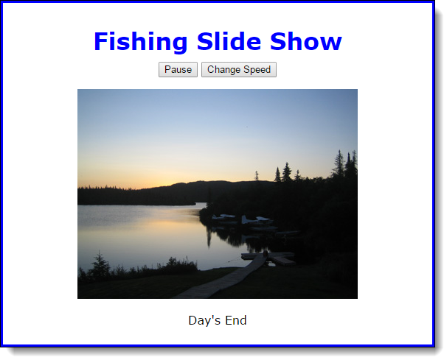
Exercise 14-2 Add a Change Speed button

Slide 57
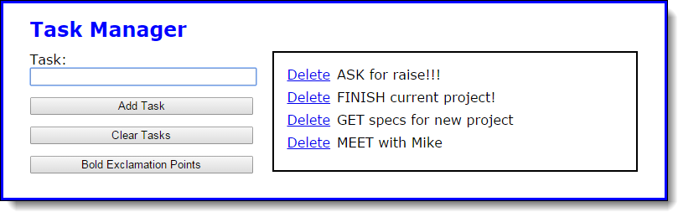
Exercise 14-3 Modify a callback function

Slide 58
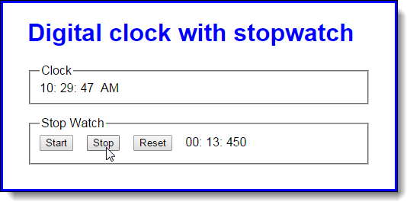
Extra 14-1 Convert the Clock app to closures

Slide 59
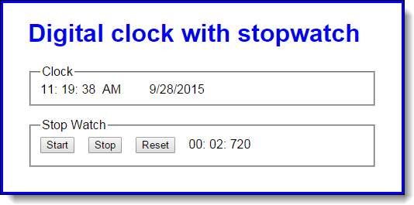
Extra 14-2 Convert the Clock app to callbacks

Slide 60
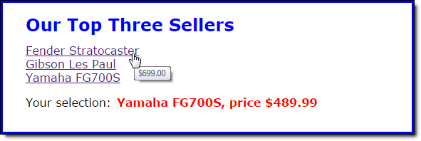
Short 14-1 Fix the closure loop problem

